Slide 1
Extended Spectrograms – Full Duration

Slide 2
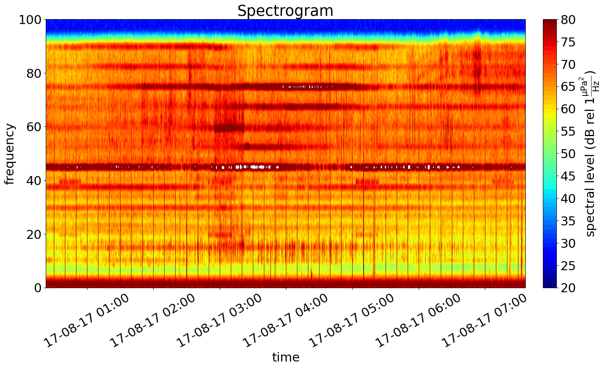
MMSI 356190000 AB
Start: 03:22:52
End: 05:37:51
3 hours before start and end

Slide 3
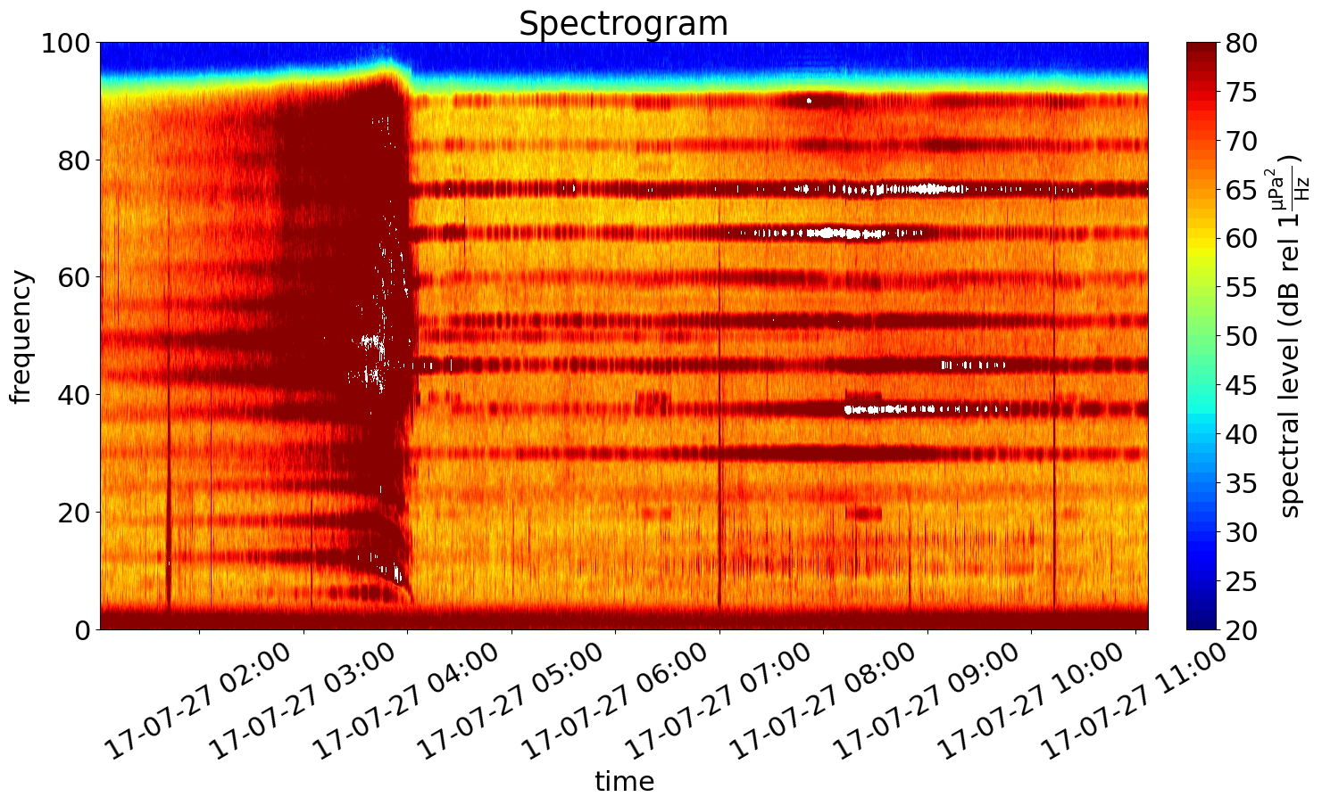
MMSI 356190000 CC
Start: 04:02:56
End: 08:07:23
3 hours before start and end

Slide 4
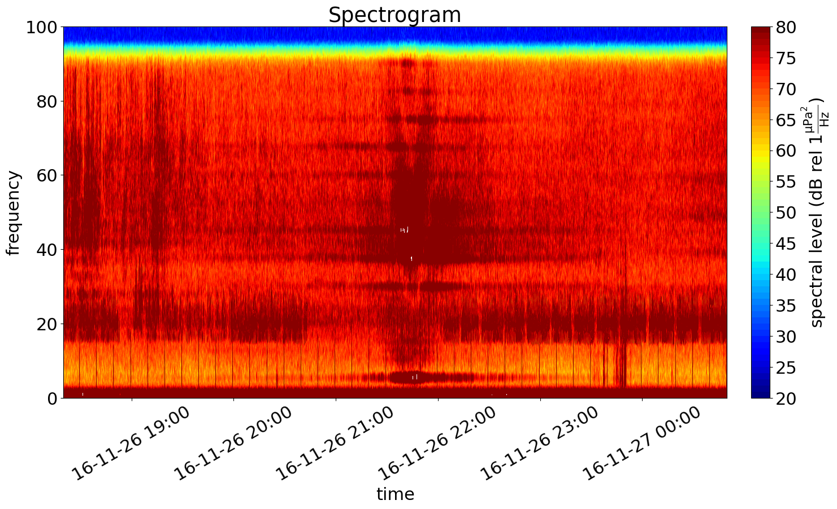
MMSI 538005544 AB
Start: 21:20:06
End: 21:49:48
3 hours before start and end

Slide 5
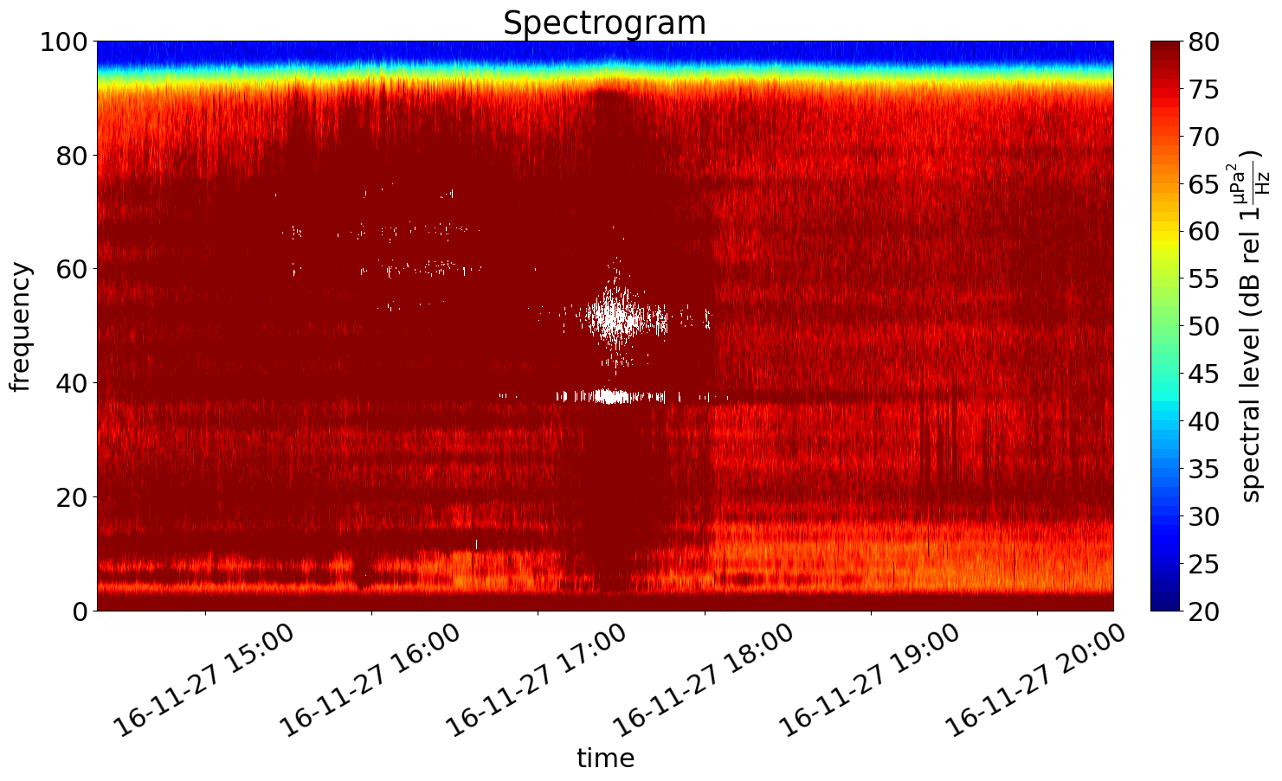
MMSI 538005544 CC
Start: 17:21:08
End: 17:27:37
3 hours before start and end

Slide 6
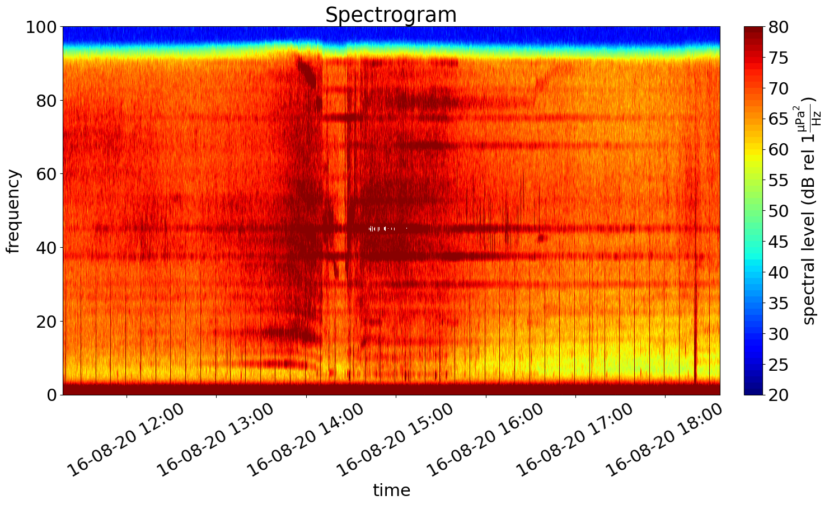
MMSI 352358000 AB
Start: 14:17:31
End: 15:36:41
3 hours before start and end

Slide 7
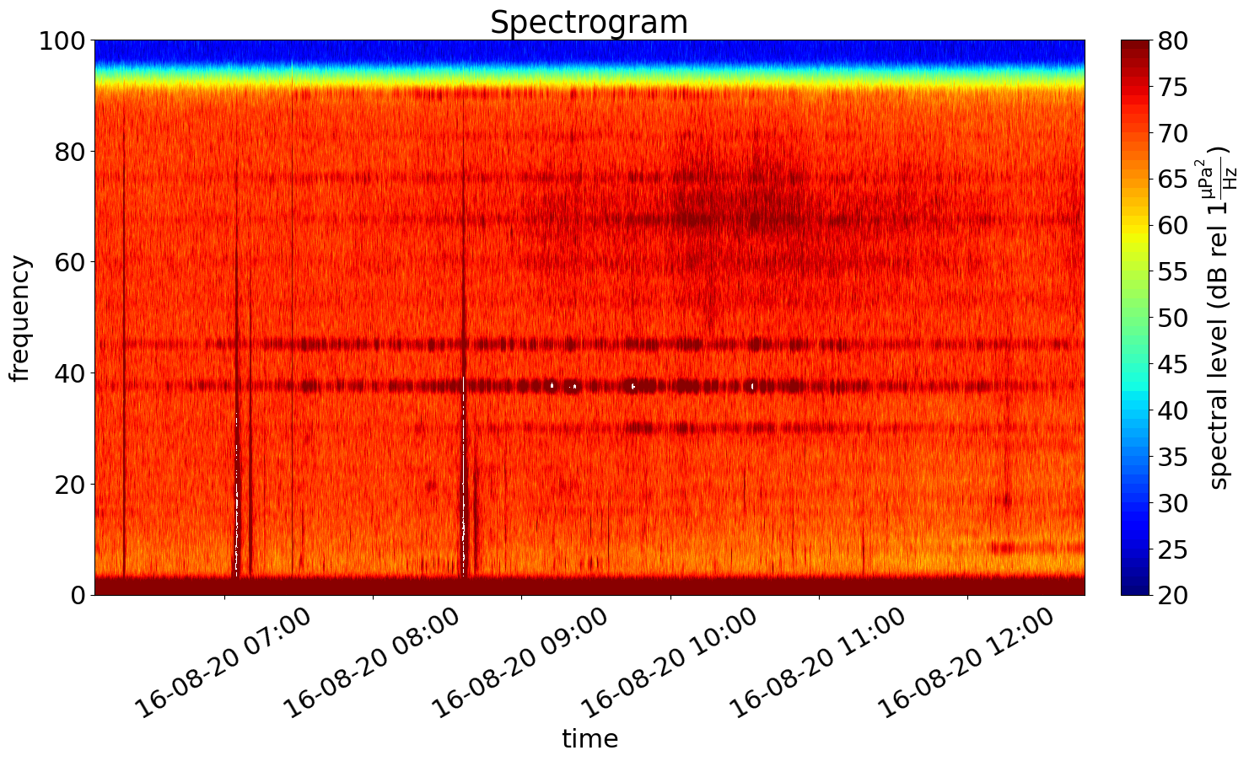
MMSI 352358000 CC
Start: 09:07:51
End: 09:47:19
3 hours before start and end

